Slide 1


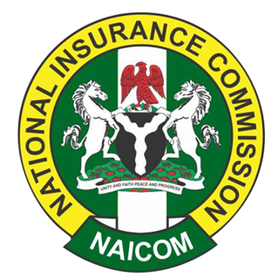
October 2025
ECONOMIC UPDATE
Nigeria’s economy maintained a steady footing in October 2025, building on the momentum from the previous months. The local currency continued to strengthen, with the naira appreciating to ₦1,427.5/$ in the official market and ₦1,460/$ in the parallel market, a notable improvement from the ₦1,478.0/$ recorded in both markets in the September.
The sustained upward trend reflects increased dollar inflows, effective liquidity management by the CBN and renewed investor confidence, particularly following Nigeria’s long-awaited exit from the FATF grey list; a development that has improved the international reputation of the country, allowing for stronger foreign investment inflows.
Inflation continued on a downward trajectory with headline inflation easing further to 18.02% in September, marking the sixth consecutive month of moderations, supported by a slowdown in food and core inflation signaling price stability in the economy.
Foreign reserves rose to $43.2 billion, driven by higher oil receipts, steady remittances, and increased portfolio inflows. This improvement has given the CBN more flexibility to manage FX liquidity and sustain ongoing market reforms.
According to the International Monetary Fund (IMF), Nigeria’s real GDP is projected to grow by 3.9% in 2025 and further to 4.2% in 2026, reflecting improved investor sentiment, stronger oil production, and ongoing reform momentum. The IMF noted that continued progress in fiscal consolidation and exchange rate unification will be critical to sustaining this positive trajectory.
MARKET UPDATE
The fixed-income and equities markets posted a mixed but broadly positive performances in October, reflecting improved investor sentiment amid sustained macroeconomic stability. The average bond yield declined to 15.77%, extending the bullish momentum from the previous month. The rally was supported by renewed demand from institutional investors following the MPC decision to cut the MPR at 27% in September.
Similarly, the Treasury Bills market saw continued buying interest, with the average yield moderating to 17.12%, driven by strong subscription levels at the primary auctions. The 364-day paper cleared at 16.14% at the final auction of the month, compared to 16.78% in September, as investors positioned for sustained disinflation and currency stability.
In the bond market, the DMO conducted successful reopening across benchmark maturities, with lower marginal rates recorded for the 2030 and 2032 issuances at 15.83% and 15.85%, respectively. Meanwhile, the equities market extended its positive run, with the NGX-ASI advancing by 8.00% to close October on a stronger note supported by renewed buying interest during the earnings season, as investors repositioned ahead of Q3 corporate results and in response to improving macroeconomic indicators.
INDUSTRY UPDATE
FG approves ₦758bn bonds to clear pension backlogs, says PenCom DG
PenCom, NAICOM order insurers to enforce pension, insurance compliance
PenCom, ICPC sign MoU to recover unremitted pension funds, enforce compliance
The Federal Government has approved ₦758 billion in bonds to offset long-standing pension liabilities, including pension increases owed since 2007. The DG of the National Pension Commission, Omolola Oloworaran, disclosed this at a two-day sensitization workshop on the workings of the Contributory Pension Scheme. Read more
The National Pension Commission (PenCom) and the National Insurance Commission (NAICOM) have jointly directed insurance companies in Nigeria to suspend all business dealings with employers that fail to comply with statutory pension and insurance obligations. Read more
PenCom and the Independent Corrupt Practices and Other Related Offences Commission (ICPC) have signed a Memorandum of Understanding (MoU) aimed at recovering unremitted pension contributions and enforcing compliance across sectors. Read more

Slide 2

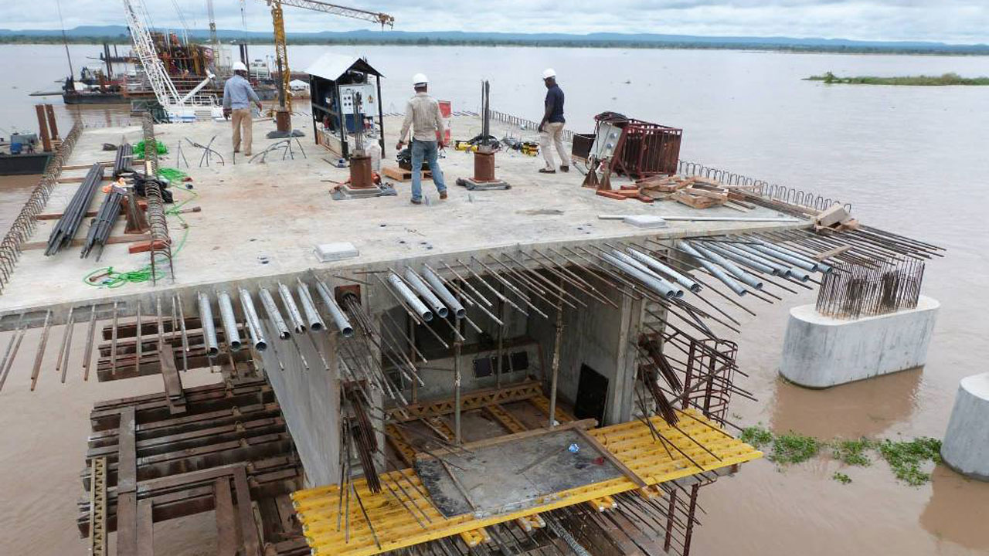
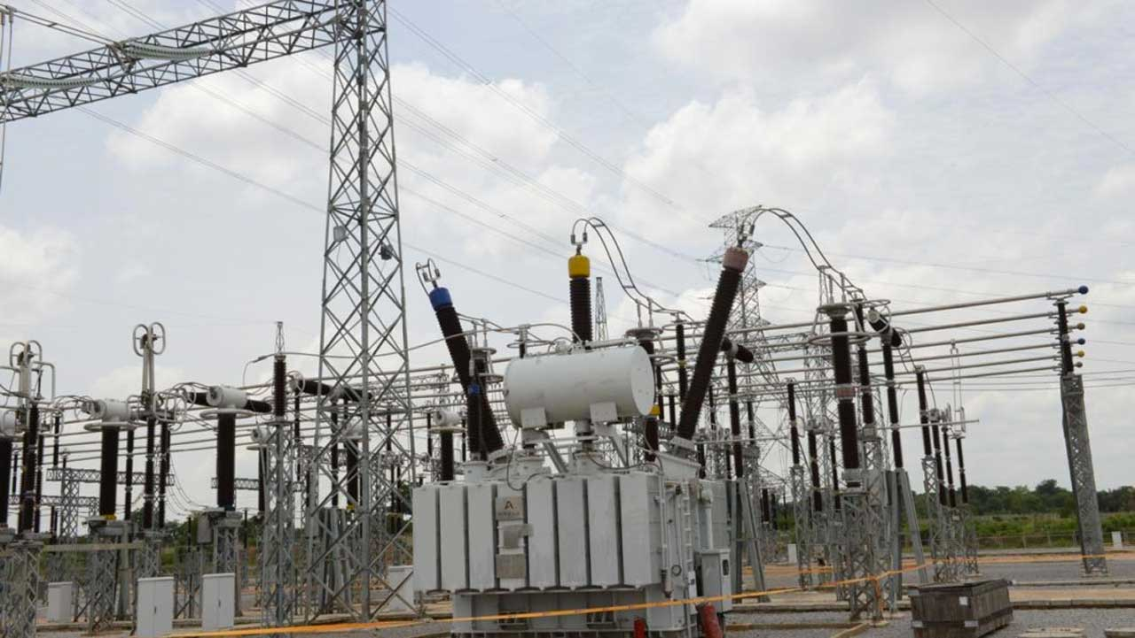
FUND PERFORMANCE – OCTOBER
 | Fund I | Fund II | Fund III | Fund IV | Fund V | Fund VI (Active) | Fund VI (Retiree)
Performance (%) | 3.36% | 2.25% | 1.67% | 1.27% | 1.34% | 1.95% | 1.72%
Allocation
Bonds | 24.70% | 57.13% | 61.93% | 54.17% | 41.93% | 24.94% | -
Equities | 22.96% | 15.17% | 10.50% | 0.56% | - | - | -
Money Market/Tbills | 48.63% | 20.68% | 26.23% | 44.44% | 58.07% | 75.06% | 100.00%
Alternative assets | 3.71% | 7.02% | 1.34% | 0.83% | - | - | -
Others | - | - | - | - | - | - | -
Your pension savings is driving economic development
Our investments in infrastructure bonds and funds play a pivotal role in advancing Nigeria’s infrastructure development, particularly in road construction and rehabilitation across key regions. By channelling capital into these projects, we are helping to close the nation’s infrastructure gap, improve regional connectivity, and promote the efficient movement of people and goods. These initiatives not only stimulate economic activity but also enhance social inclusion and overall quality of life for Nigerians.
STAY SAFE, STAY SMART: SECURITY TIPs
BEWARE OF “HELLO MA/SIR” SCAMMERS
That polite message you received on WhatsApp or the DM promising to help you “upgrade” your bank account or fix a mysterious issue? No fall Mugu. If it sounds too good or too urgent, take a step back. Scammers often use sweet talk to trick people always confirm from your bank or through official channels before acting.
AVOID ATM GBAS GBOS
When using an ATM:
Shield your PIN like you're guarding your jollof rice at a party.
Avoid using ATMs at night or in isolated locations.
If the ATM swallows your card, don’t accept help from strangers go straight to your bank.
DON’T SHARE OTP LIKE PUFF PUFF
Your OTP (One-Time Password) is for your eyes only. Even if someone says they’re from Norrenberger or your bank, never share it. We’ll never ask you for that code and fraudsters know it’s the key to your money.
WHEN IN DOUBT, REACH OUT
Unsure about a message or call? Contact the company directly. It’s safer to confirm than be scammed.

